Slide 1
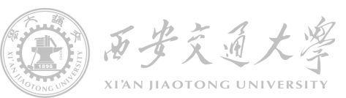

Power electronics device in ordinary life
Seminar #1 Report
810 | Nie Yongxin | Make the ppt & collect the data
 | Chang Yi | Make the ppt & collect the data
 | She Xiaoliang | Make the ppt & collect the data

Slide 2








Brief introduction
Function
Basic principle
Input and output features
Dismantling diagram
category
Circuit diagram
Component

Slide 3



目录
Category
Background information
The specific meaning of switching power supply is to use modern electronic technology to control the switching time ratio and maintain stable output voltage.
At present, the switching power supply with the characteristics of small size, light weight, high stability and easy to carry is more popular. In addition, these characteristics of switching power supply make it widely used in many electronic devices.
The future development of switching power supply must be high frequency, high reliability, good safety, low energy consumption, less pollution and strong anti-interference ability. At present, many foreign countries make use of the characteristics of switching power supply to continuously develop new high intelligent components.
Introduction
function
principle
features
dismentling
circuit
component

Slide 4
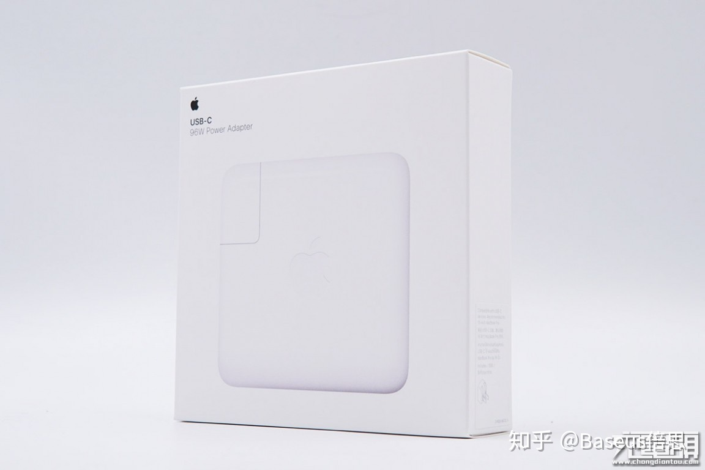

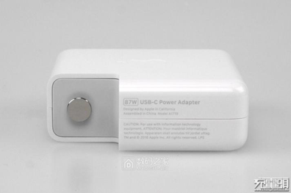
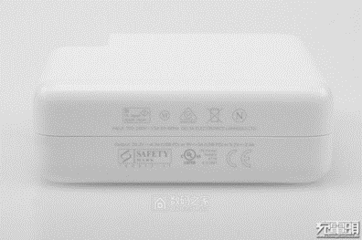
目录
Category
The 87W Power Adapter for Mac
Introduction
function
principle
features
dismentling
circuit
component

Slide 5
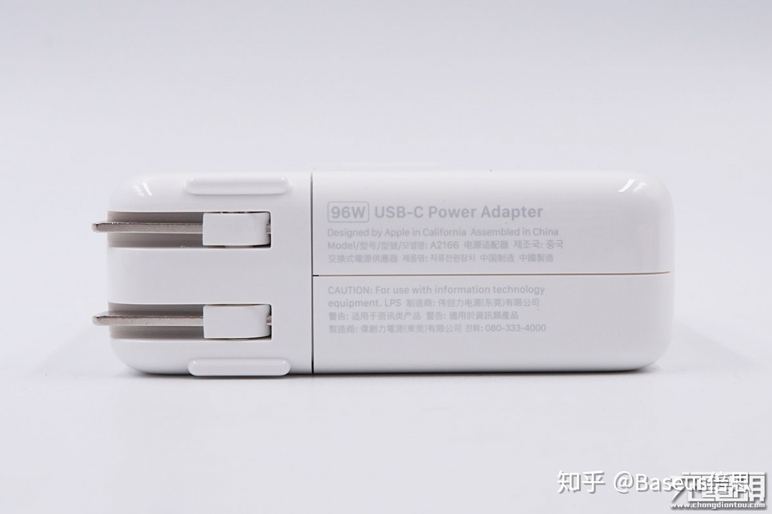
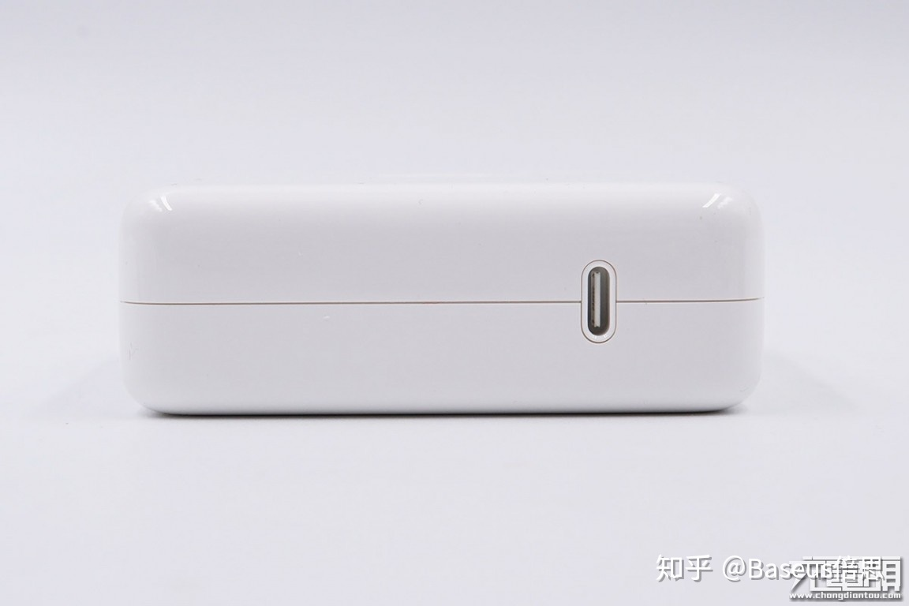
目录
Basic function
Category
To begin with, the adapter is used to charge the Macbook, a kind of laptop produced by Apple Inc, whose power stage is 87 watts. This adapter support input voltage, from 100V to 240V, input current, 1.5A and the frequency, from 50Hz to 60Hz. Meanwhile, the adapter also supports 4 different kinds of output features including 20.5V+4.7A, 15V+3A, 9V+3A and 5.2V+3A, which could be used as the charger of any equipment supporting PD charging.
Introduction
function
principle
features
dismentling
circuit
component

Slide 6
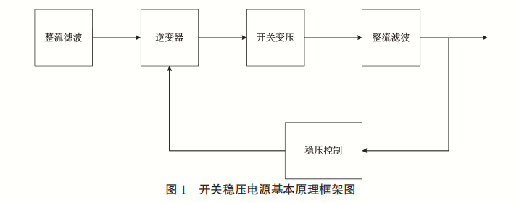
目录
Basic principle of switching power supply
Category
Rectifying filter
inverter
Switch voltage transformation
Introduction
function
principle
features
Voltage stabilizing control
dismentling
circuit
component

Slide 7
目录
specific input and output features
Category
Introduction
function
principle
features
dismentling
circuit
component

Slide 8
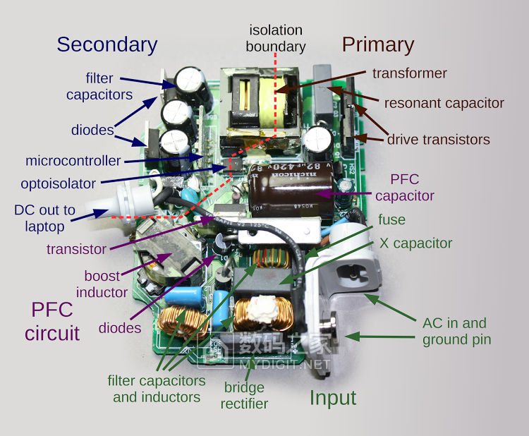
目录
dismantling diagram
Category
Introduction
function
principle
features
dismentling
circuit
Power Factor Correction
component

Slide 9
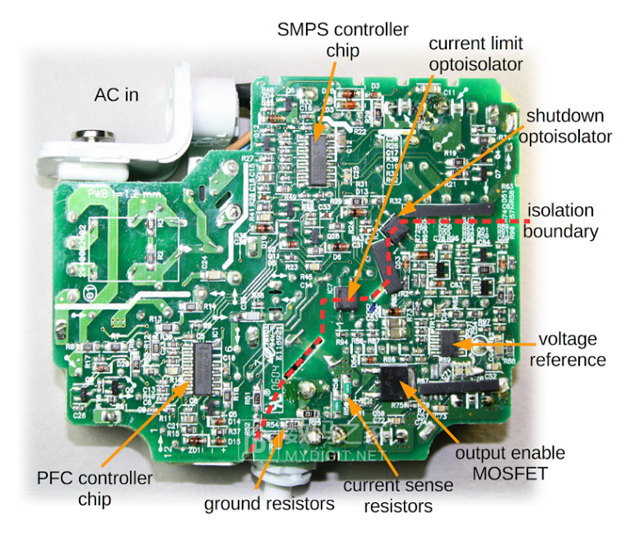
目录
dismantling diagram
Category
Symmetric Multiprocessor System
Introduction
function
principle
features
dismentling
circuit
component

Slide 10
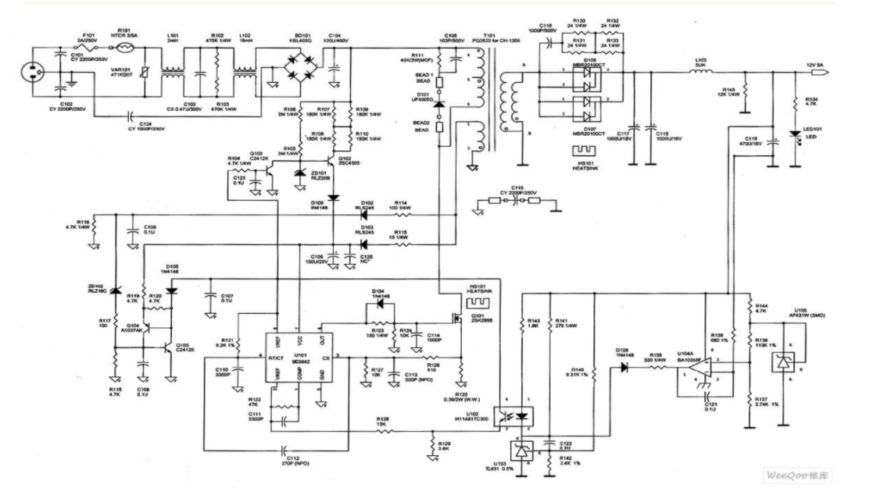
目录
Circuit diagram
Category
Introduction
function
principle
features
dismentling
circuit
component

Slide 11
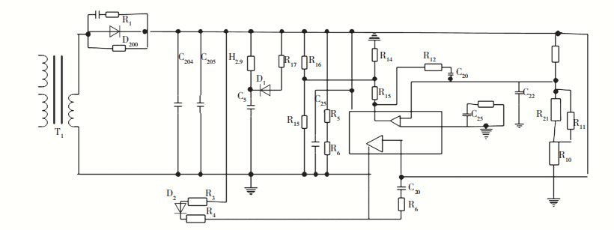
目录
Category
Control circuit schematic diagram
Introduction
function
principle
features
dismentling
circuit
component

Slide 12
目录
Category
Introductory remarks
Introduction
Varistor.
Inductance coil
Rectifier bridge.
Filter capacitor.
Temperature probe
High power switch tube
Switching transformer
Secondary rectifier tube
function
principle
features
dismentling
circuit
component

Slide 13
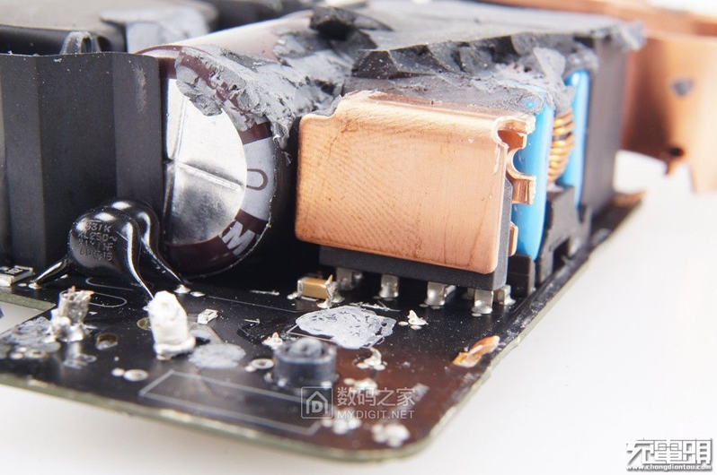
目录
Category
Component
Introduction
function
principle
features
dismentling
circuit
component

Slide 14
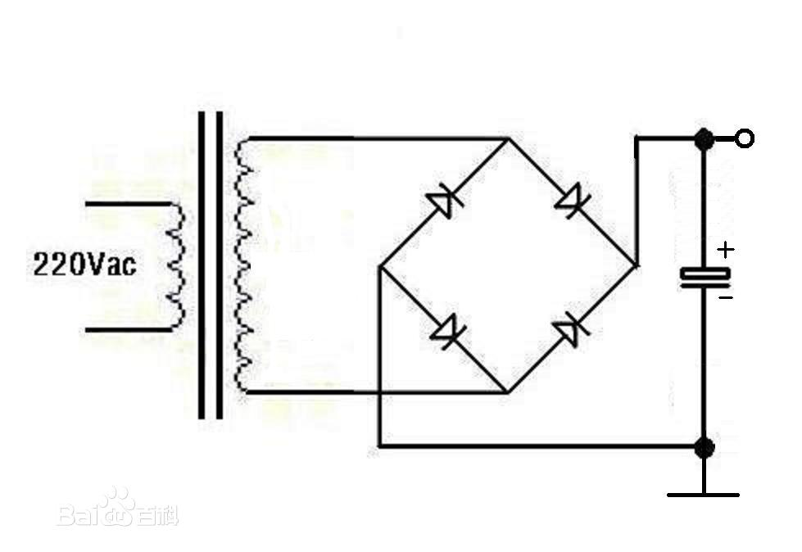
目录
Bridge rectifier circuit
Category
Introduction
function
principle
features
dismentling
circuit
component

Slide 15
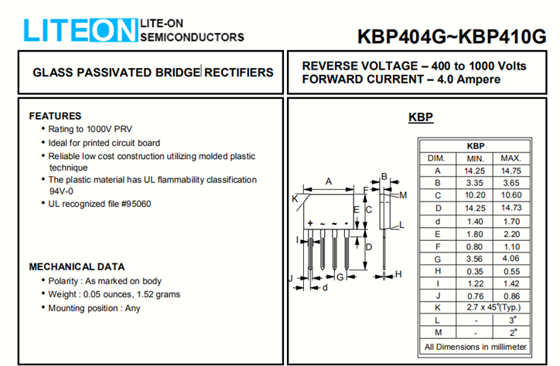
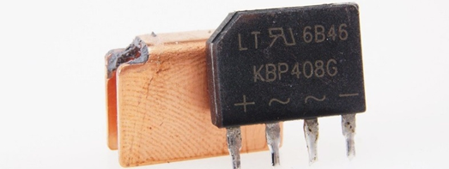
目录
Component
KBP408G
Category
Introduction
function
principle
features
dismentling
circuit
component

Slide 16
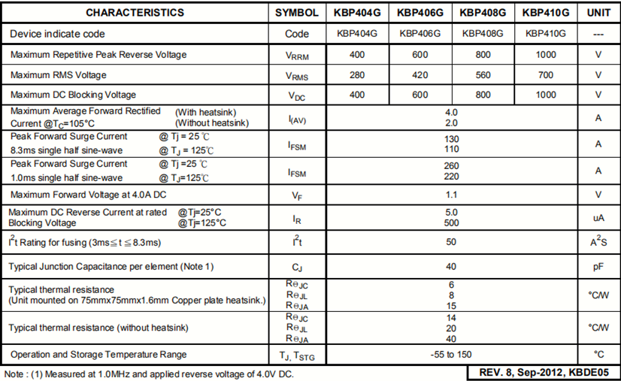
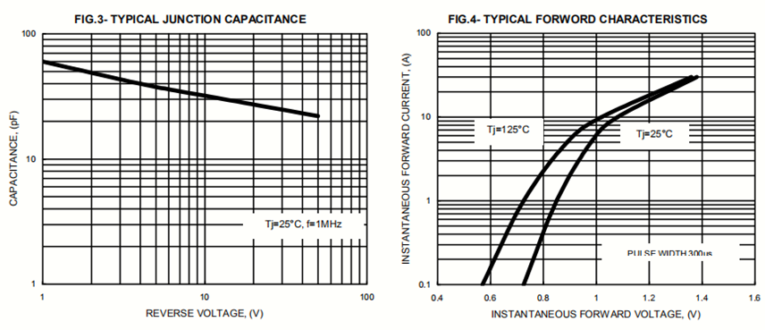
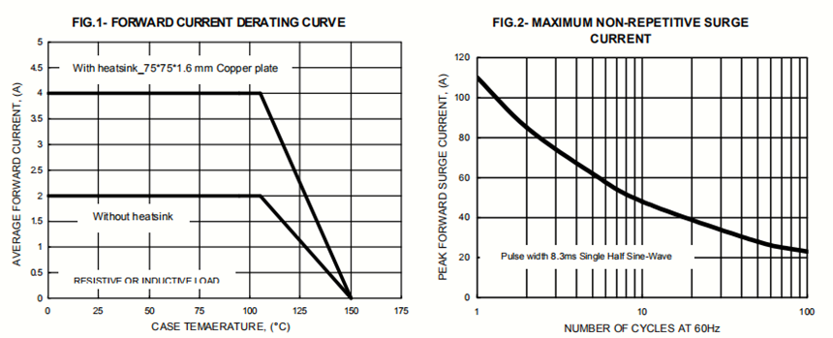
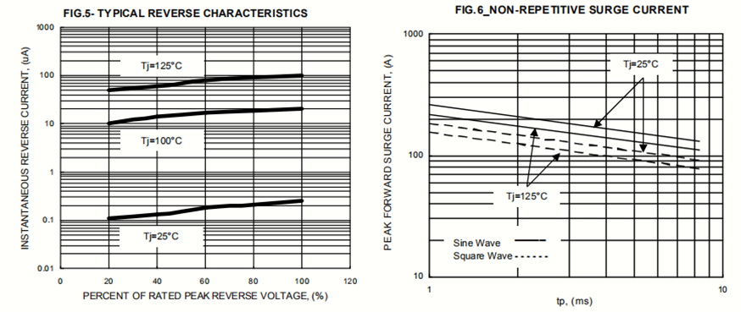
KBP408G
目录
Category
Introduction
function
principle
features
dismentling
circuit
component

Slide 17

Questioning session
Your questions and
your valuable comments
are welcome

